Slide 1
House Price Analysis
Ali Masood
f2022266014

Slide 2
Problem Statement
The goal of this project is to develop a predictive model that estimates house prices using historical data. Accurate price prediction supports better decision-making for buyers, sellers, and real estate professionals.

Slide 3
Dataset Overview
Collected from Zameen.com and provided by howisusmanali on Kaggle
https://www.kaggle.com/datasets/howisusmanali/house-prices-2023-dataset
70k listings for training and testing(80:20 split) and 30k listings for final testing

Slide 4
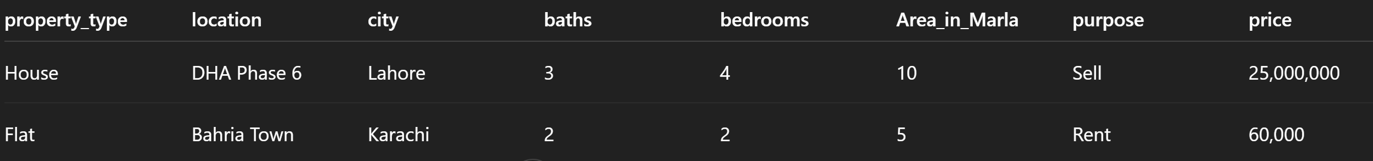
Dataset Overview

Slide 5
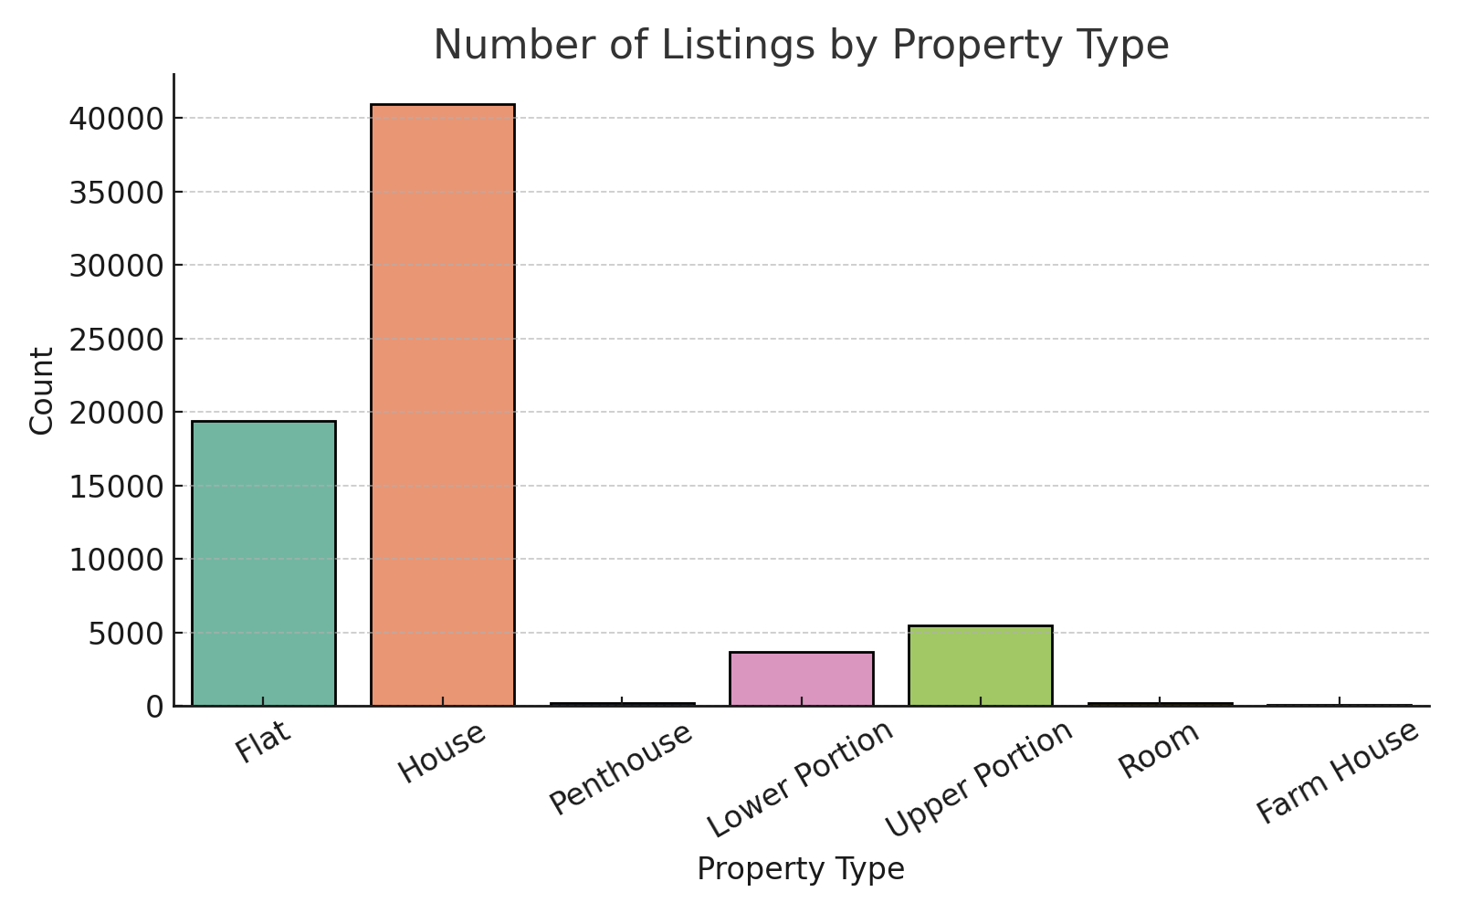
Listings by Property Type

Slide 6
This project focuses on predicting house prices using machine learning.
• Model: Random Forest Regressor
Model

Slide 7
Random Forest selected for its robustness and performance.
200 Trees
Max Depth: 20
Log-transformed price target for accuracy.
Why Random Forest?

Slide 8
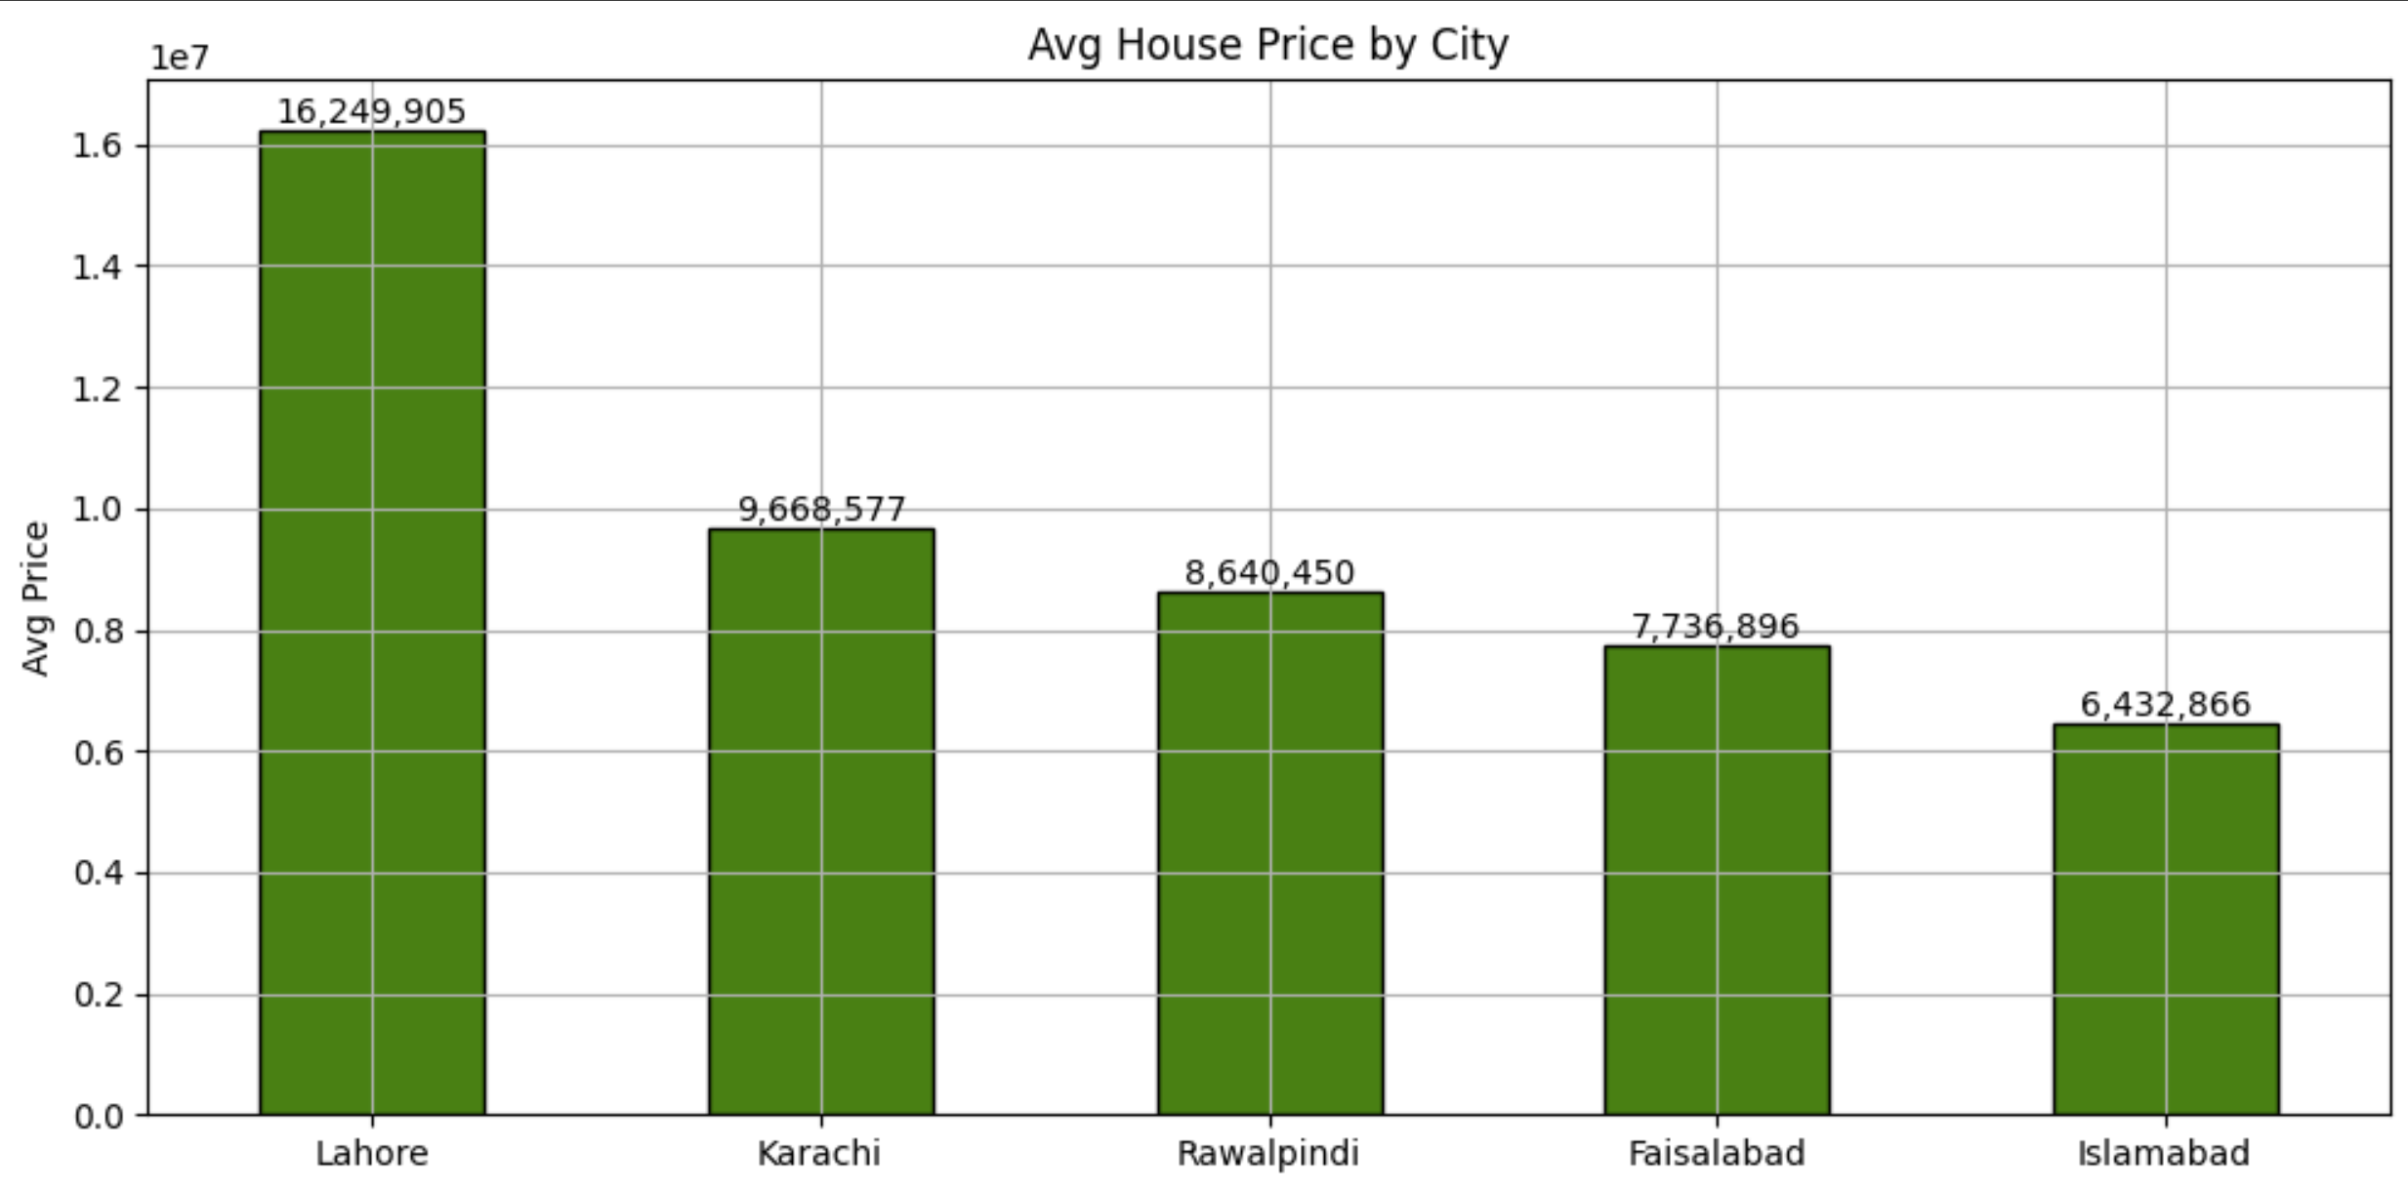
Average Price by City

Slide 9
The model evaluation was performed using:
RMSE - Root Mean Square Error
R² Score - Coefficient of Determination
Approximate Accuracy: 90%
Evaluation

Slide 10
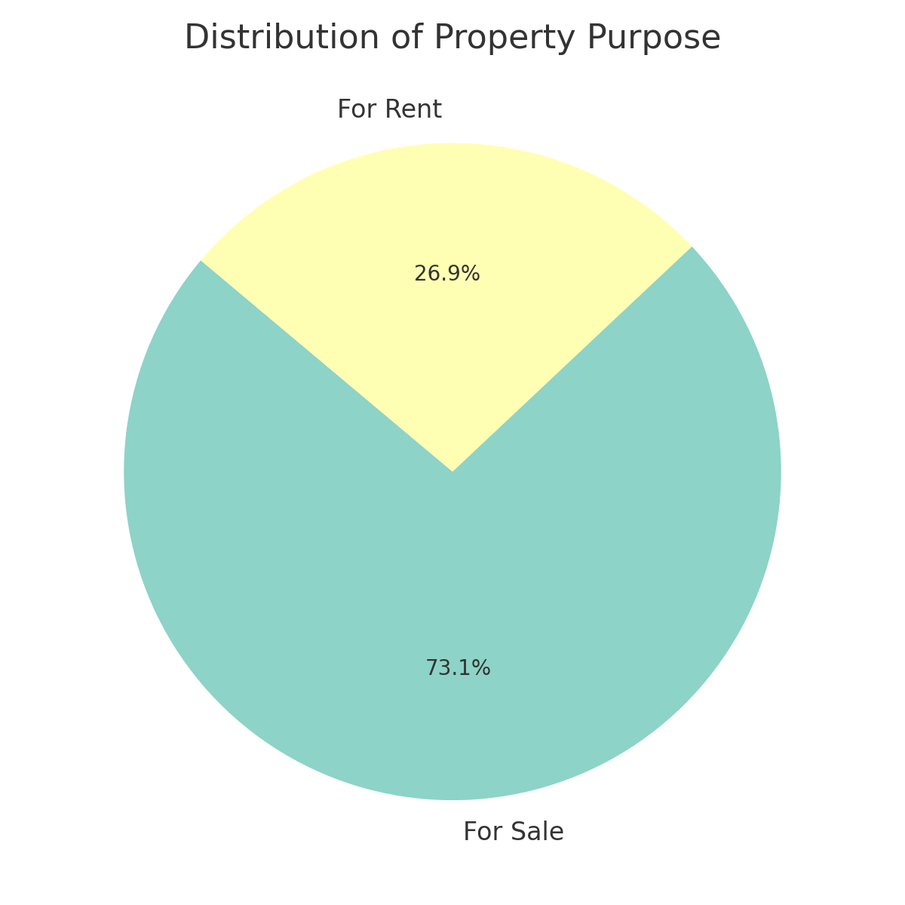
Purpose of Listing

Slide 11
Future Work
More location features
Deploy as web app

Slide 12
Any Question?

